Slide 1

Speech Emotion Recognition (SER)
Waseema Begum
Praveena Kumari Silmala

Slide 2

Objective
The intended objective of this project is to build a deep learning model that could recognize emotions in the speech we constantly exchange with one another.
Nowadays personalization is something that is needed in all the things we experience everyday.

Slide 3
Value
SER(Speech Emotion Recognition) can be used in call center for classifying calls according to emotions and as the performance parameter for conversational analysis thus identifying the unsatisfied customer, customer satisfaction and so on.. for helping companies improving their services.
It can also be used in car board system based on information of the mental state of the driver can be provided to the system to initiate his/her safety preventing accidents to happen.
This can be used by multiple industries to offer different services, like an ecommerce company suggesting customers to buy products based on their emotions.

Slide 4
Relevant Work
B.J. Abbaschian, D. Sierra-Sosa, A. Elmaghraby
Sensors, 21 (2021), p. 1249
View article
Deep learning techniques for speech emotion recognition, from databases to models
M.B. Akçay, K. Oğuz
Speech Communication, 116 (2020) , pp. 56-76
View article
Speech emotion recognition: Emotional models, databases, features, preprocessing methods, supporting modalities, and classifiers
F. Andayani, L.B. Theng, M.T. Tsun, C. Chua
IEEE Access, 10 (2022), pp. 36018-36027
View article
Hybrid LSTM-Transformer model for emotion recognition from speech audio files

Slide 5

Approach
Datasets
Toronto emotional speech set (Tess)
Surrey Audio-Visual Expressed Emotion (Savee)
Crowd-sourced Emotional Multimodal Actors Dataset (Crema-D)
Ryerson Audio-Visual Database of Emotional Speech and Song (Ravdess)
Data Preparation
As we want to work with four different datasets, so we will be creating a data frame storing all emotions of the data in data frame with their paths.
We will use this data frame to extract features for our model training.
Data Augmentation
Data augmentation is the process by which we create new synthetic data samples by adding small perturbations on our initial training set.
To generate syntactic data for audio, we can apply noise injection, shifting time, changing pitch and speed.
The objective is to make our model invariant to those perturbations and enhance its ability to generalize.

Slide 6
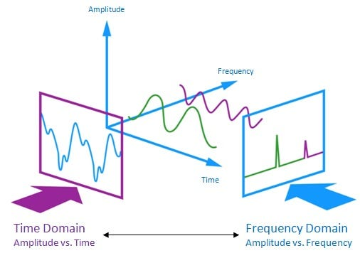
The audio signal is a three-dimensional signal in which three axes represent time, amplitude and frequency.
Feature Extraction
As we already know that the data provided of audio cannot be understood by the models directly, so we need to convert them into an understandable format for which feature extraction is used.
With the help of the sample rate and the sample data, one can perform several transformations on it to extract valuable features out of it, like zero crossing rate, energy, entropy of energy, spectral centroid, spectral spread etc.
Modeling
Will choose deep learning model like Recurrent Neural Networks (RNNs) as it can capture temporal dependencies in audio data and are well-suited for time-series information.
Also, Will try to improve the model by including CRNNs and Transformers, so that we can combine predictions from multiple models.

Slide 7

Evaluation
Once model is trained, will use appropriate evaluation metrics (on testing data) like:
Accuracy - To measure overall classification performance).
F1 Score - To balance precision and recall).
Precision and Recall - To understand how well positive (negative sentiment) cases are classified.
Confusion Matrix - To analyze false positives and false negatives).
Mean Opinion Score (MOS).

Slide 8
Deliverables
Technical report – To summarize the project's objectives, methods, findings, and outcomes.
Code - All project code and deliverables will be posted to a GitHub repository.
Video File/Link – A video group presentation will be created and posted on a platform explaining the project.

Slide 9

Thank You

